Slide 1
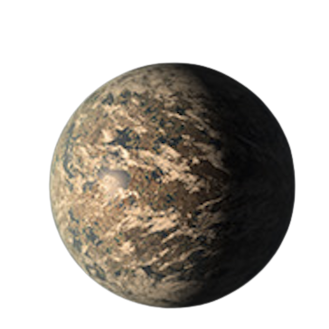
Build-a-Planet: Trappist-1e
Group 1: Cassie Moats, Matt Lastovka, Kolya Larson, Sam Eckart, William Wu

Slide 2
Background
Rocky planets have unique composition
Planetary chemical composition → search for Earth-like planets

Slide 3
Methods
Trappist-1e
Took data from NASA Exoplanet Archive
Radius: ~0.9 R_Earth
Believed to be rocky due to radius
Used ExoPlex to calculate possible structure
Mass and radius → Trappist-1e’s average density
Host star composition → Trappist-1e’s structure

Slide 4
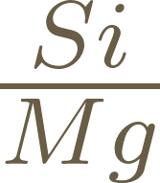


Calculating Molar Ratios to use ExoPlex
Input mass of Trappist-1e & molar ratios from host star
Calculate and using Griffith et al. 2021
Scaled [Fe/H] = 0.0535 ± 0.08 to [Mg/Si] and [Fe/Mg]
Then calculated log abundance between elements and H
A = 12 + log
Notes:
Figure 3 from Griffith was used
X is an element and A is solar abundance
Calculated for Fe, Si, and Mg

Slide 5
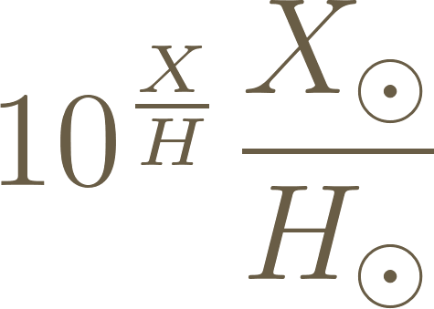
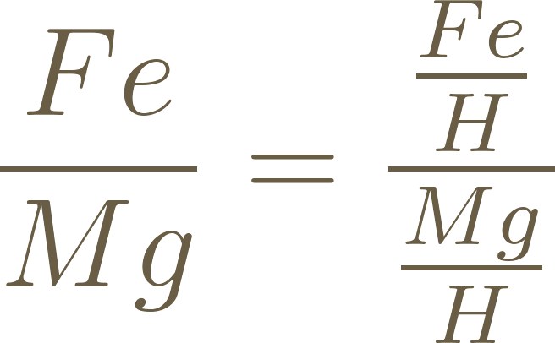
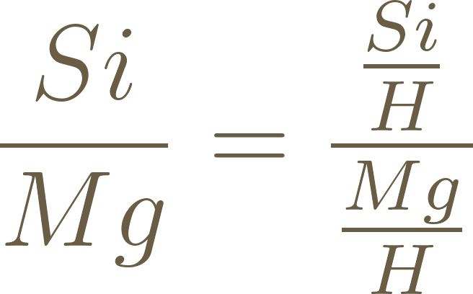
Calculating Molar Ratios to use ExoPlex
Convert solar abundances to molar ratios
=
Division to get in terms of Mg
= 0.7943
= 0.8913
Notes:
Figure 3 from Griffith was used
X is an element and A is solar abundance
Calculated for Fe, Si, and Mg

Slide 6
ExoPlex
Assume planet abundance is the same as stellar abundance
Inputs: Mass = 0.629, Fe/Mg = 0.79, Si/Mg = 0.89
Adjust parameters to get known results for Trappist-1e
Inputs: Mass = 0.692, Fe/Mg = 0.56, Si/Mg = 0.89
Parameters of Trappist-1e
Notes:
Known result → radius

Slide 7
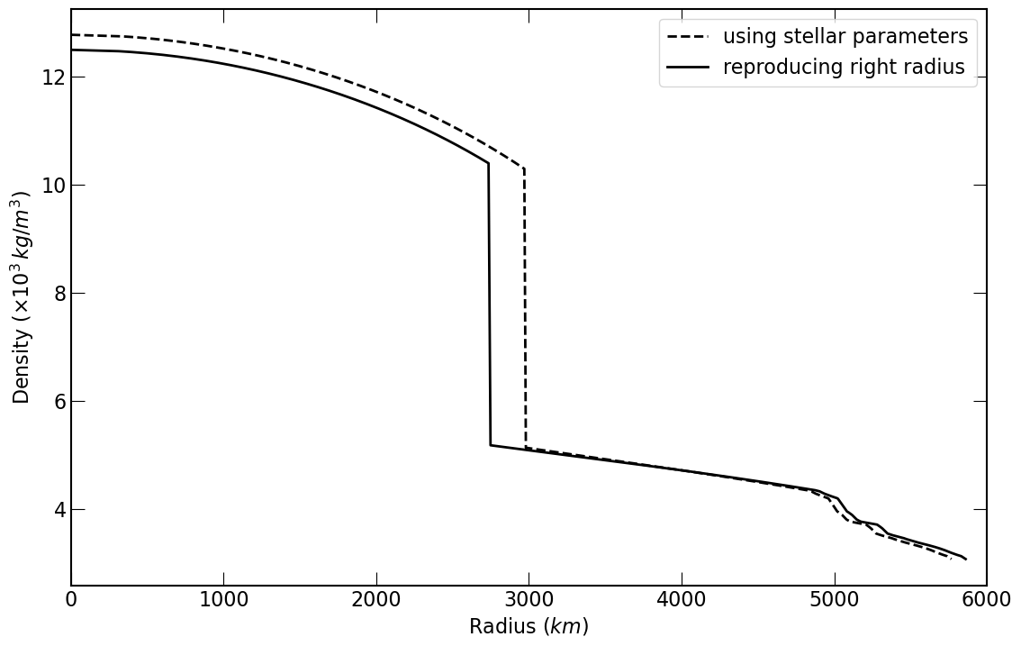

Slide 8
Comparing Trappist-1e to Known Terrestrial Planet
Size and orbital distance
Plotted exoplanet archive data with Trappist-1e’s data
Trappist-1e is closer to Trappist-1 than Earth is to the Sun
Also slightly less dense based on our calculations
Need to compare solar irradiation to Earth’s
Notes:
From this plot, it was clear Trappist-1e is terrestrial, but comparing to Solar Irradiation

Slide 9
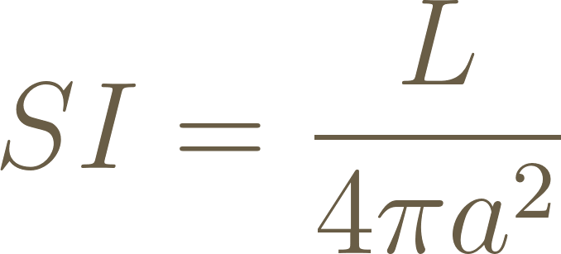
Comparing Trappist-1e to Known Terrestrial Planet
Solar Irradiation
Earth SI: 1367.52800 W/m^2
Mars SI: 589.045 W/m^2
Trappist-1e's SI: 883.91 W/m^2
Notes:
Luminosity, semimajor axis
Trappist-1e is extremely cold with or without an atmosphere

Slide 10
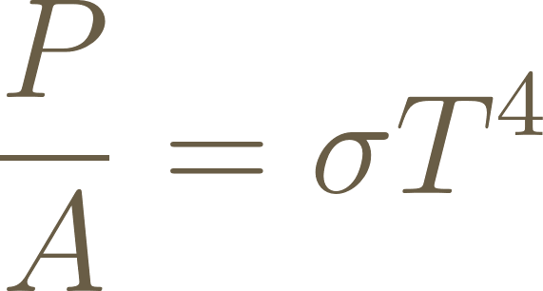
Finding the Snow Line
Stefan-Boltzmann Law
Know the power per unit area as function of semi-major axis
Water freezes at 273.15 K
Graphed SI equation and found ~315 W/m^2
Assuming Earth pressure
Snow line at a = 0.049 AU

Slide 11
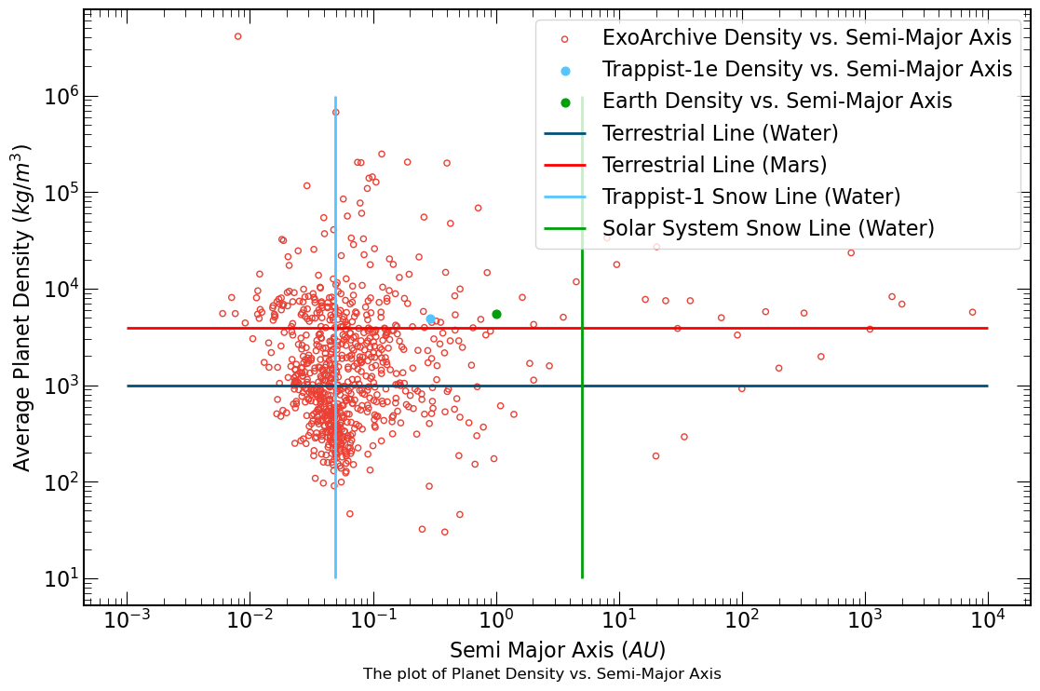
Notes:
"Terrestrial Line (Water)”
In this plot, it is placed at 1000kg/m^3 as this is the density of water (also could be given as 1 g/cm^3).
Typically, anything less dense is assumed to be gaseous, or porous enough for the gas it contains to bring the average density to less than that of water.
But this is a huge generalisation -- even several of the "Gas Giants" in our solar system are more dense than water, and they are far from what we might mean by "terrestrial."
This is where "Terrestrial Line (Mars)" comes in.
If we assume Mars has the minimum average density required to have a solid surface -- which is still inaccurate but gives a better idea of the landscape for solid surfaces -- then we can see that Trappist-1e is very likely solid on its surface

Slide 12


Mantle Mineralogy
 | Earth | Trappist-1e
FeO | 8.05 | 0.0
 | 45.0 | 52.28
MgO | 37.8 | 39.4
CaO | 3.55 | 3.84
 | 4.45 | 4.49
Notes:
McDonough and Sun (1994) from the earth composition values

Slide 13
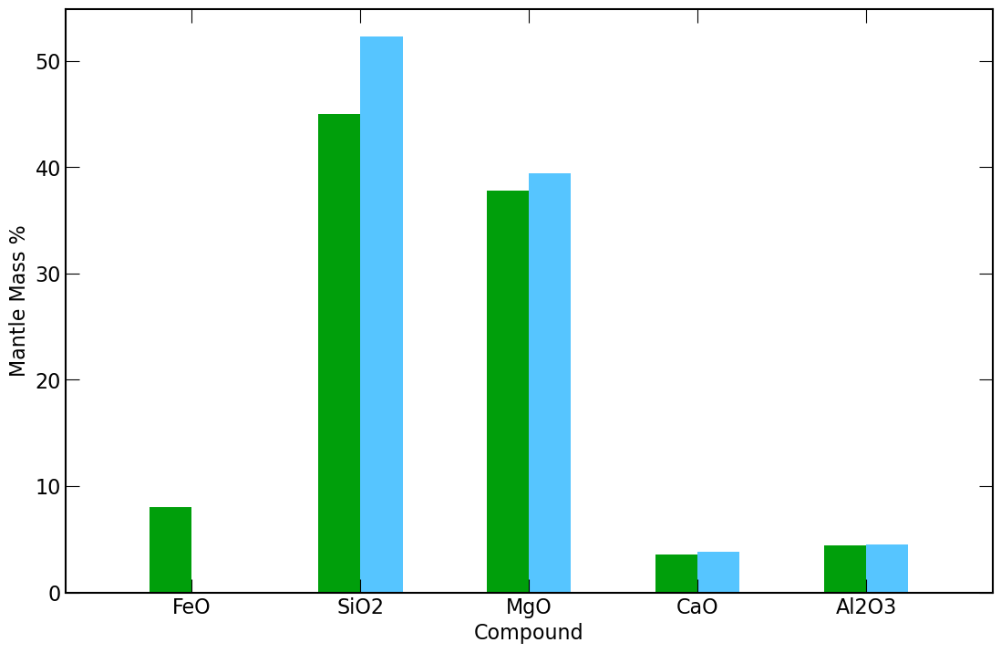
Notes:
clear to that CaO and Al2O3 are very consistent with Earth measurements
Also can see lack of iron in Trappist-1e's mantle being redistributed as increases in SiO2 and MgO to make up for the mantle mass percentage loss.

Slide 14
Conclusions
Trappist-1e density = 4.883 g/cm^3
Trappist-1e's SI: 883.91 W/m^2
64.6% of Earth’s
150% of Mars’s
Trappist-1e
Cold, rocky planet
Composition similar to Earth’s
Notes:
Less massive core relative to total mass – our calculations did assume iron core

Slide 15
